Slide 1
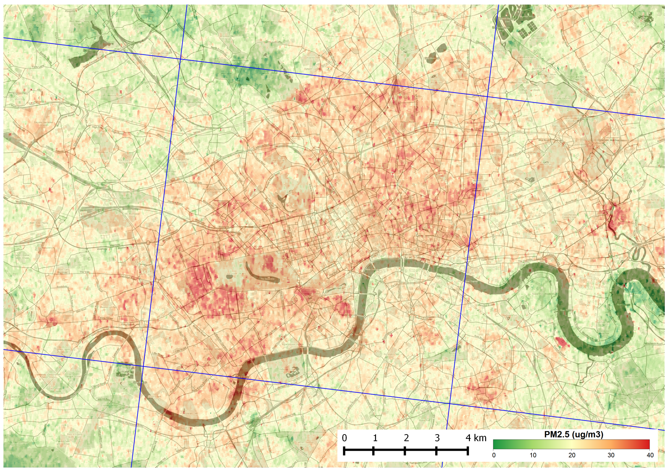
HOTBAR High-resolution PM_{2.5} measurements from satellites
Robin Wilson, University of Southampton
r.t.wilson@soton.ac.uk

Slide 2
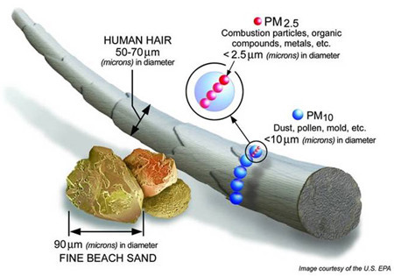
Over 3 million people die prematurely each year from particulate matter air pollution

Slide 3
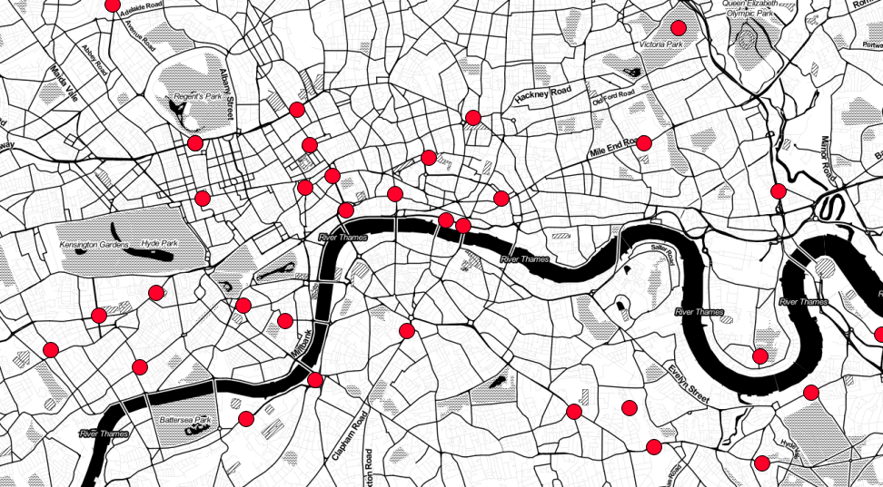
33 sites in Central London (not all measuring PM!)
3 sites in Soton (1 measuring PM)

Slide 5
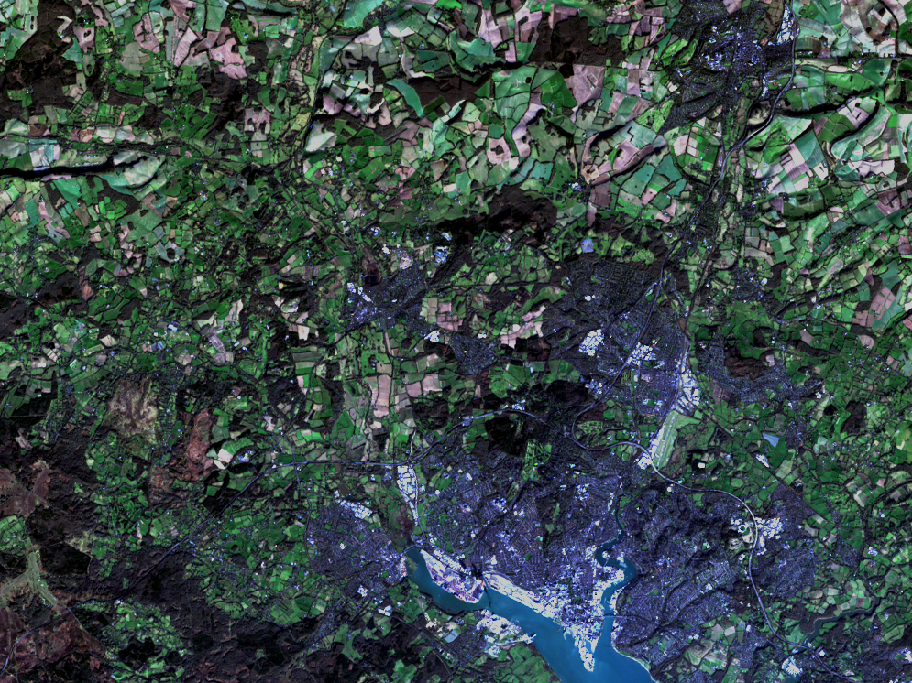
Landsat – 30m

Slide 6
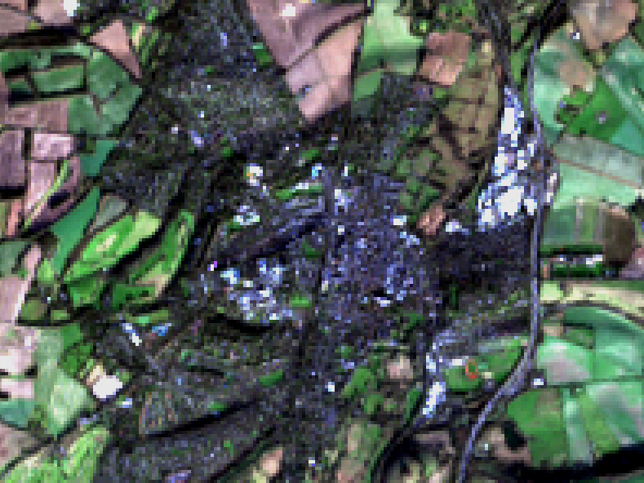
Landsat – 30m

Slide 7
MODIS
HOTBAR
Over 100,000 times the detail

Slide 9
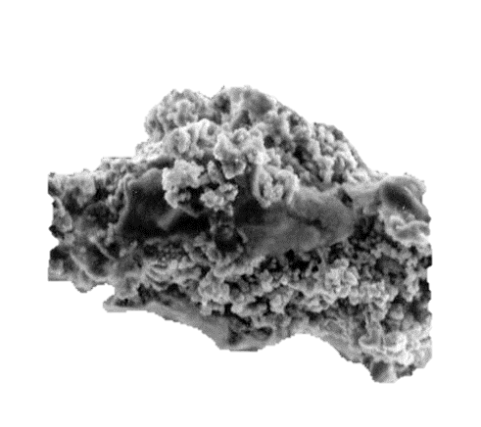
In
Scattering
Out

Slide 10
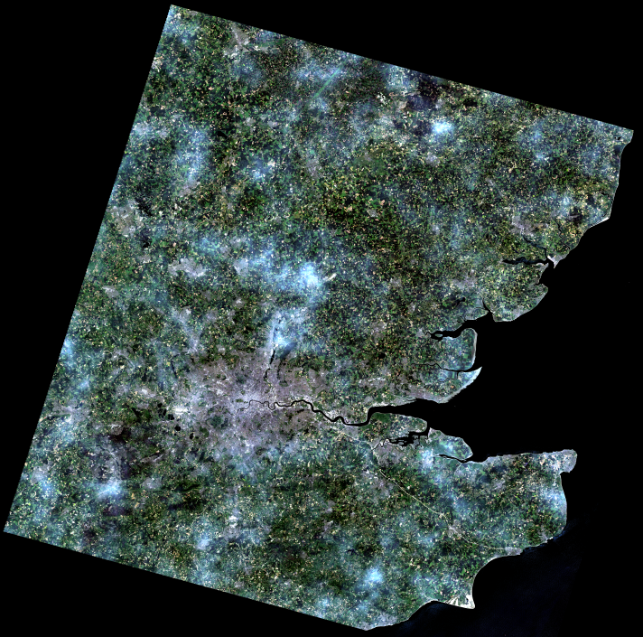

Slide 11
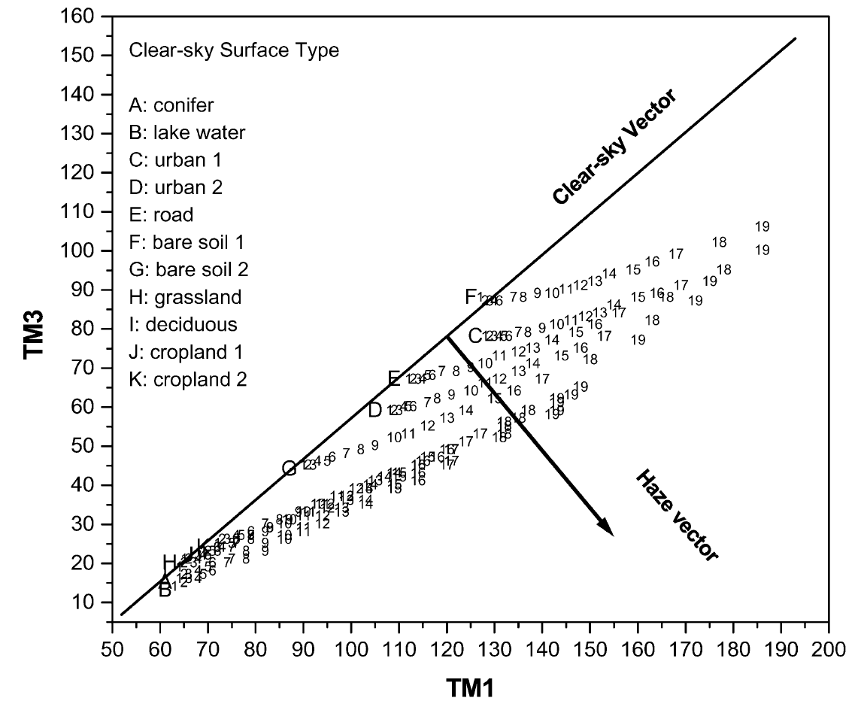
Haze Optimized Transform (HOT)
Red
Haze =
Aerosols
Blue
Zhang et al. (2002)

Slide 12
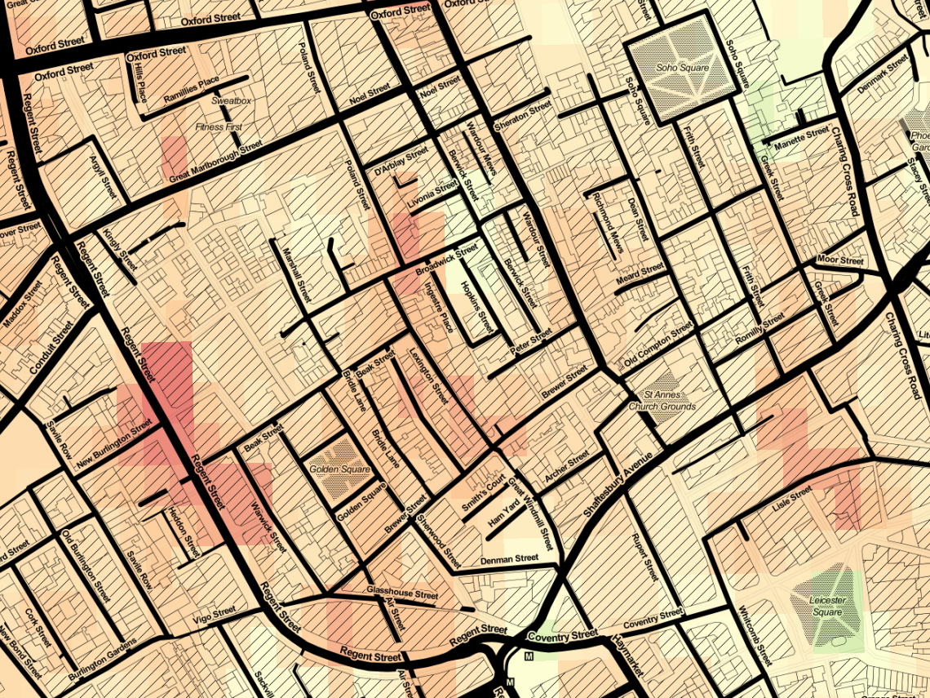

Slide 13
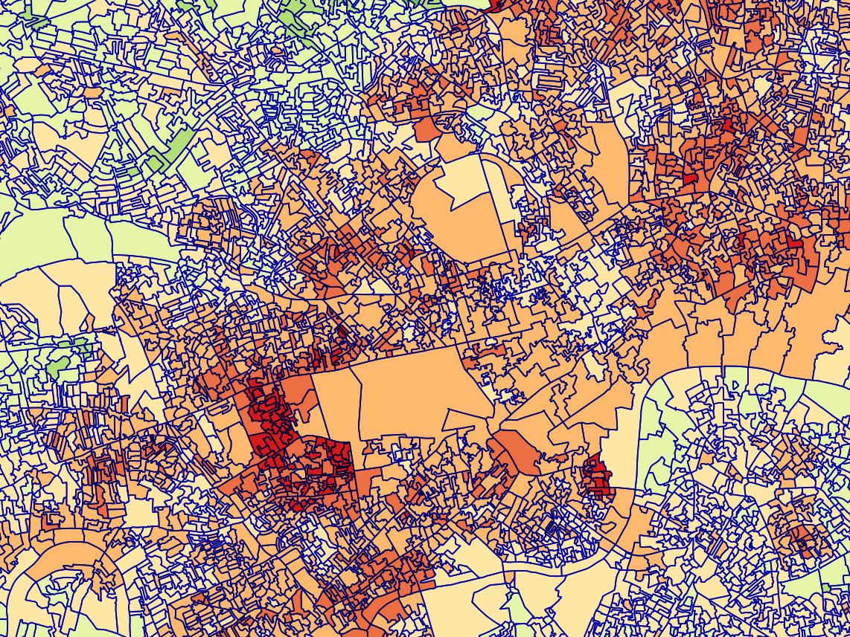

Slide 14
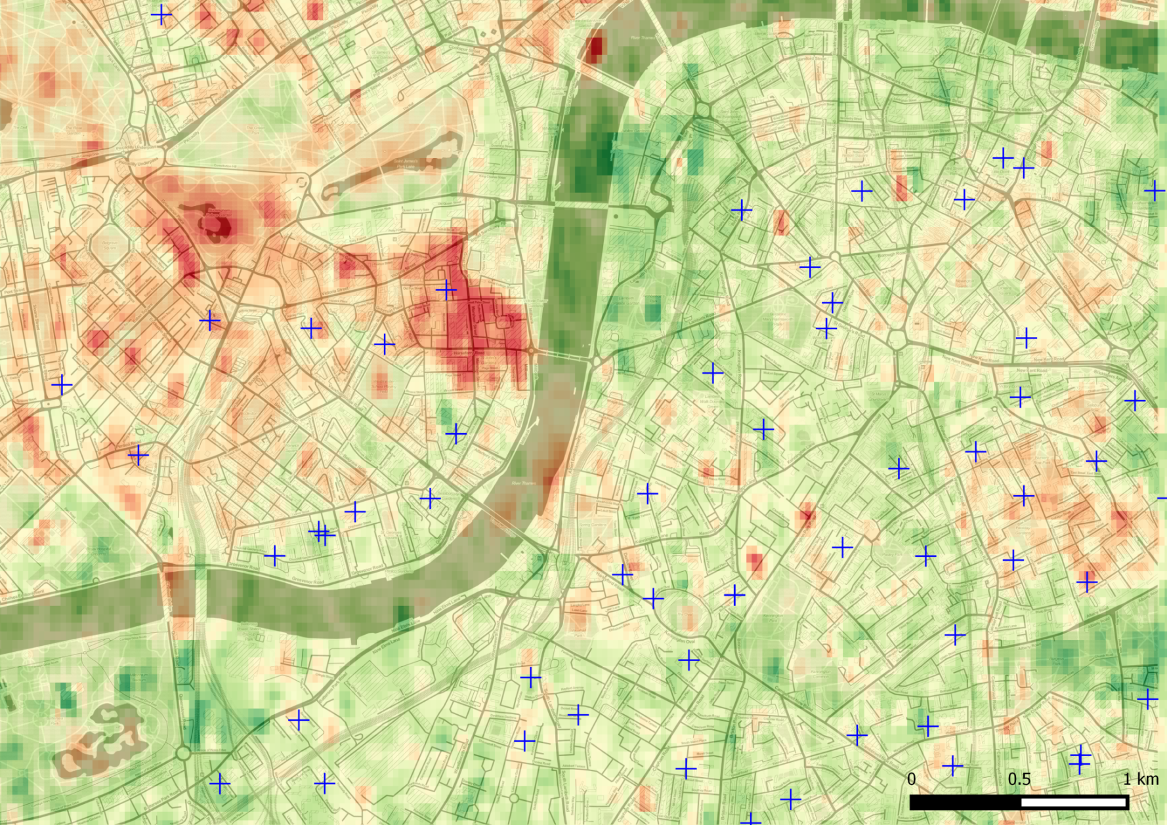

Slide 15
MODIS
(10km)
Landsat
(30m)
Sentinel-2
(20m)
Combined

Slide 16
Validation (it’s hard to do well!)
PM_{2.5} (median error)
Comparison with AURN sites 6.0μg m⁻³
Ground instrument (for comparison) 2.5μg m⁻³
Global 10km analysis (van D, 2010) 6.7μg m⁻³
All likely to decrease!

Slide 17
What next?
Currently working to improve/extend the method
What do YOU want?

