Slide 1
Image Hub at Anglo American
Robin Wilson, Senior Geospatial Data Engineer
Robin.Wilson@angloamerican.com
April 2022

Slide 3
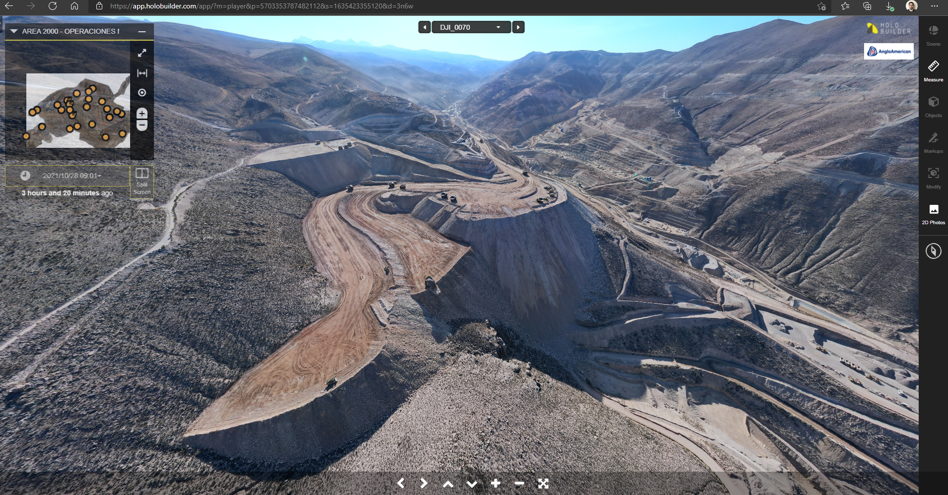
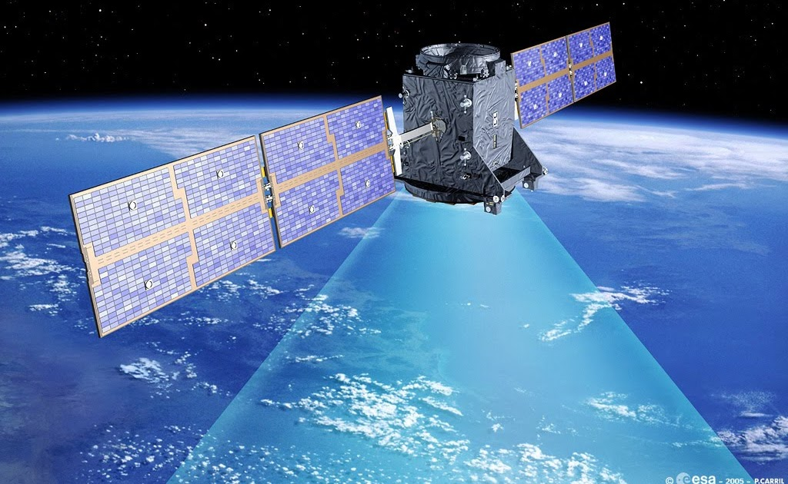
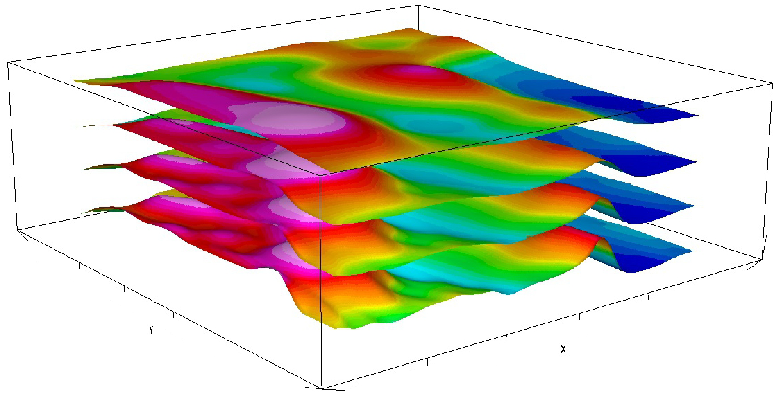
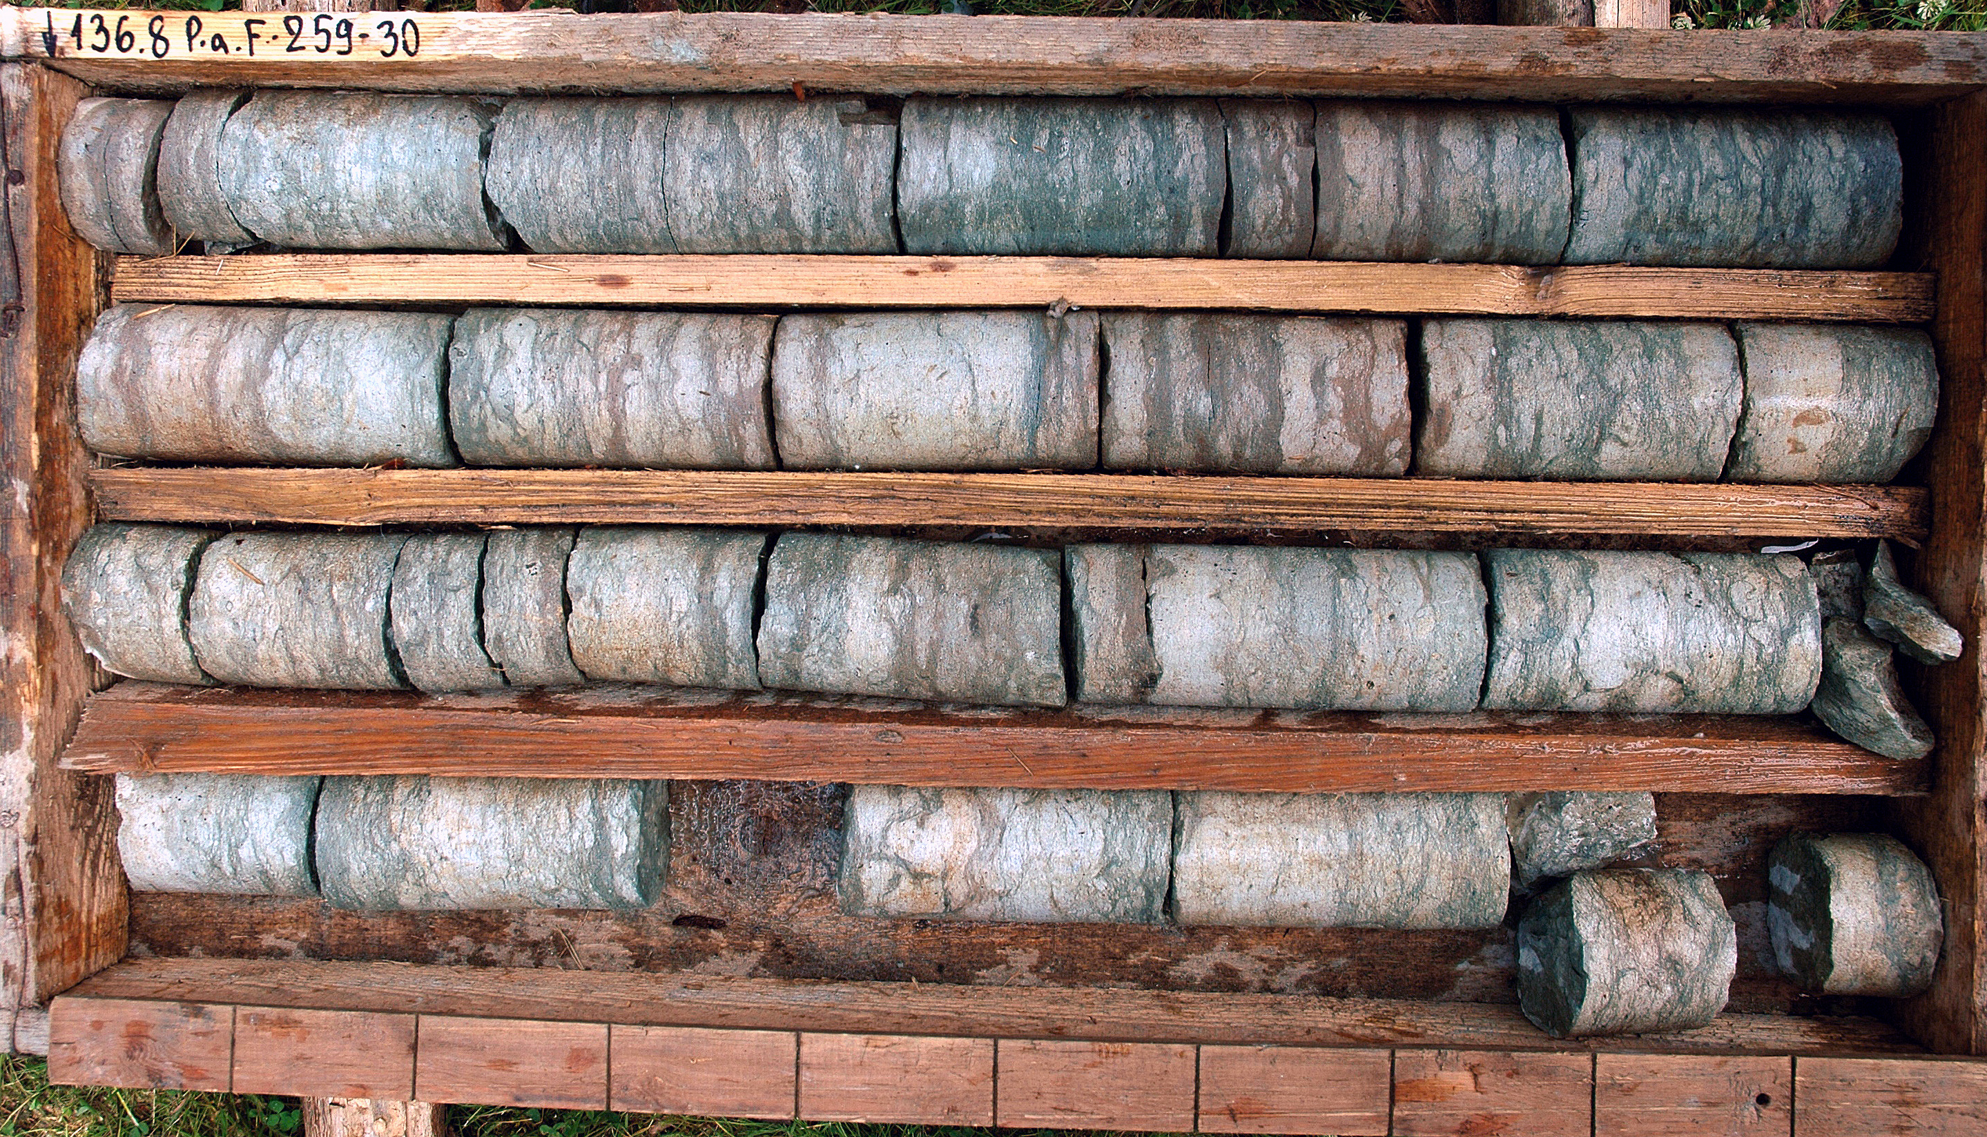
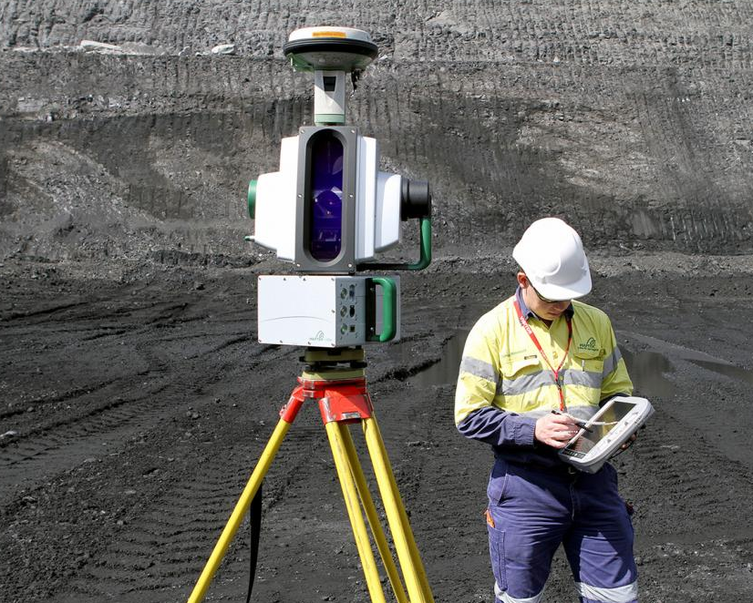

Slide 4
We need to be able to use image data at scale
Store
Search
Visualize
Compute

Slide 5
Options
Planetary Computer
+ Marigold
Notes:
We compared these 7 candidates across over 50 criteria resulting in hundreds of individual tests
Documented in detail in confluence

Slide 6
Technology Stack
Store
Search
Visualize
Compute
Azure Blob Storage
Conversion to COG with rio-cog
pgstac (Postgres)
stac-fastapi
PySTAC and rio-stac for generating STAC items
TiTiler
TiTiler-pgstac
Custom viewer app (React & FastAPI)
Dask Gateway
DaskHub / JupyterHub

Slide 7
From zero to proof-of-concept demo in a month!
How?
Engaged small team
Good documentation
Easy to gradually increase complexity
static catalog → dynamic catalog
tiling one image → mosaic tiling
Off-the-shelf demo apps
Titiler Viewer / stacdiscovery / Planetary Computer
Very responsive open-source projects & community

Slide 8
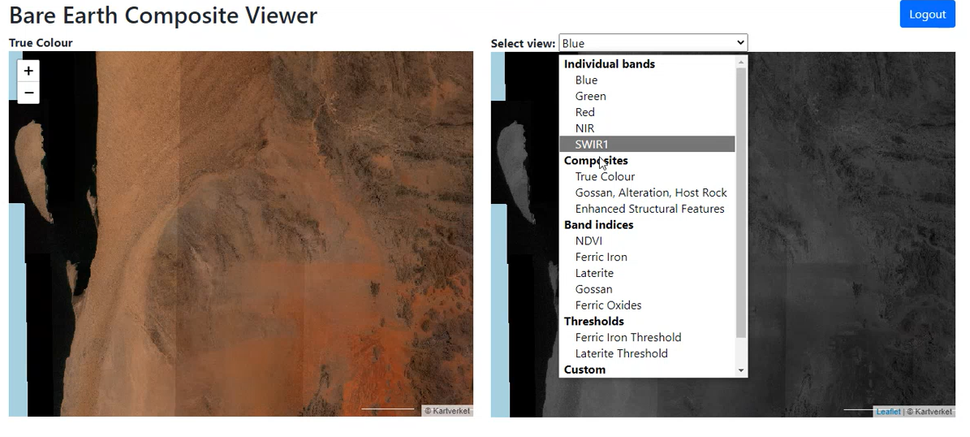
POC Viewer example

Slide 9
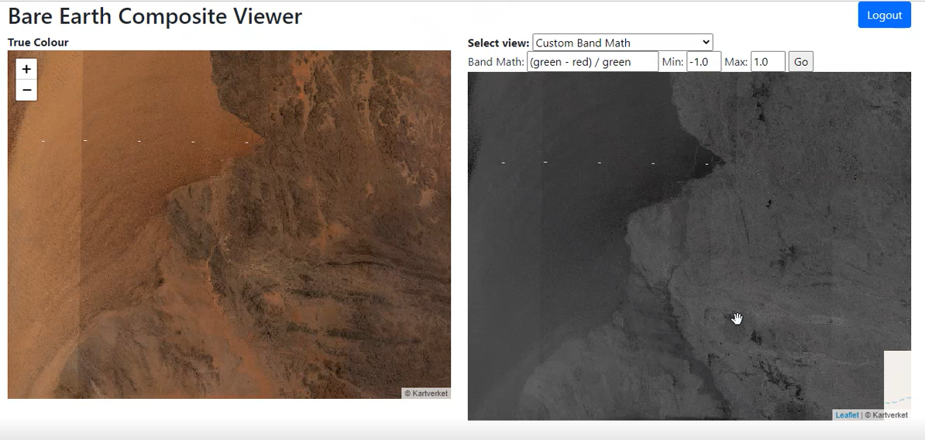
POC Viewer example

Slide 10
Current Status
Agreed as the technology stack for Image Hub
Deployed in sandbox environment
~40Tb of data catalogued
Proof of concept viewer deployed
Progressing with design approvals within Anglo

Slide 11
Challenges & Issues
Security
Speed
Doesn’t feel like security in STAC ecosystem was built-in from the start
Designed more for open-data?
Integrating tokens, logins, secure access to Blobs etc requires a reasonable amount of work
Tiling of mosaics can be slow and hard to debug
Not sure how to do fast global mosaics at low zoom levels
Creating STAC items with lots of extension metadata can be slow
ArcGIS integration
Internal approvals
No ArcGIS plugin for STAC
Limitations in XYZ tile layers in ArcGIS – particularly around security
Get momentum around ArcGIS support?
Technologies not used before in Anglo
Open-source more widely accepted but still requires approvals
Integration with commercial technologies (ESRI) can be tricky

Slide 12
We’re hiring!
Cloud Engineer
and
Full Stack developer (Python & React)
Contract, Remote, UK/EU ideal
CNG experience very beneficial
See: https://tinyurl.com/aafullstack
https://tinyurl.com/aacloudeng

