Slide 1
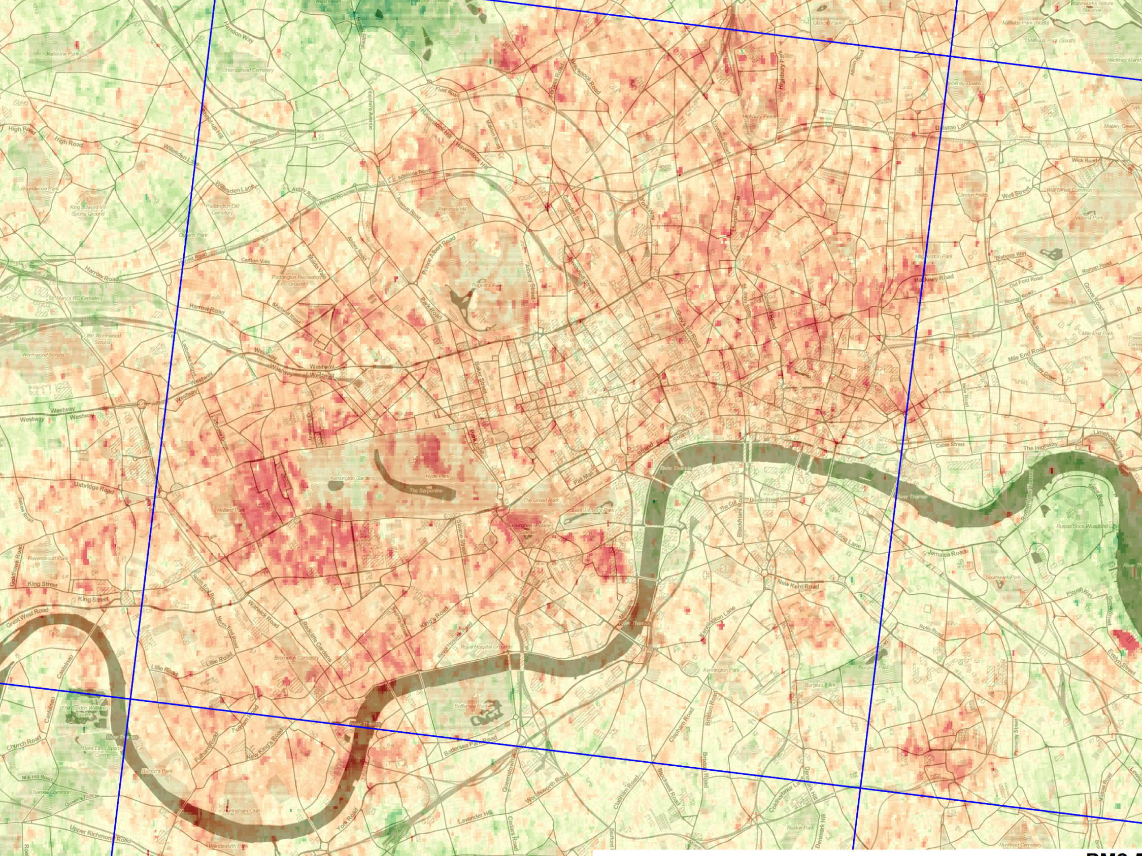
Robin Wilson
MRC Early Career Fellow

Slide 2
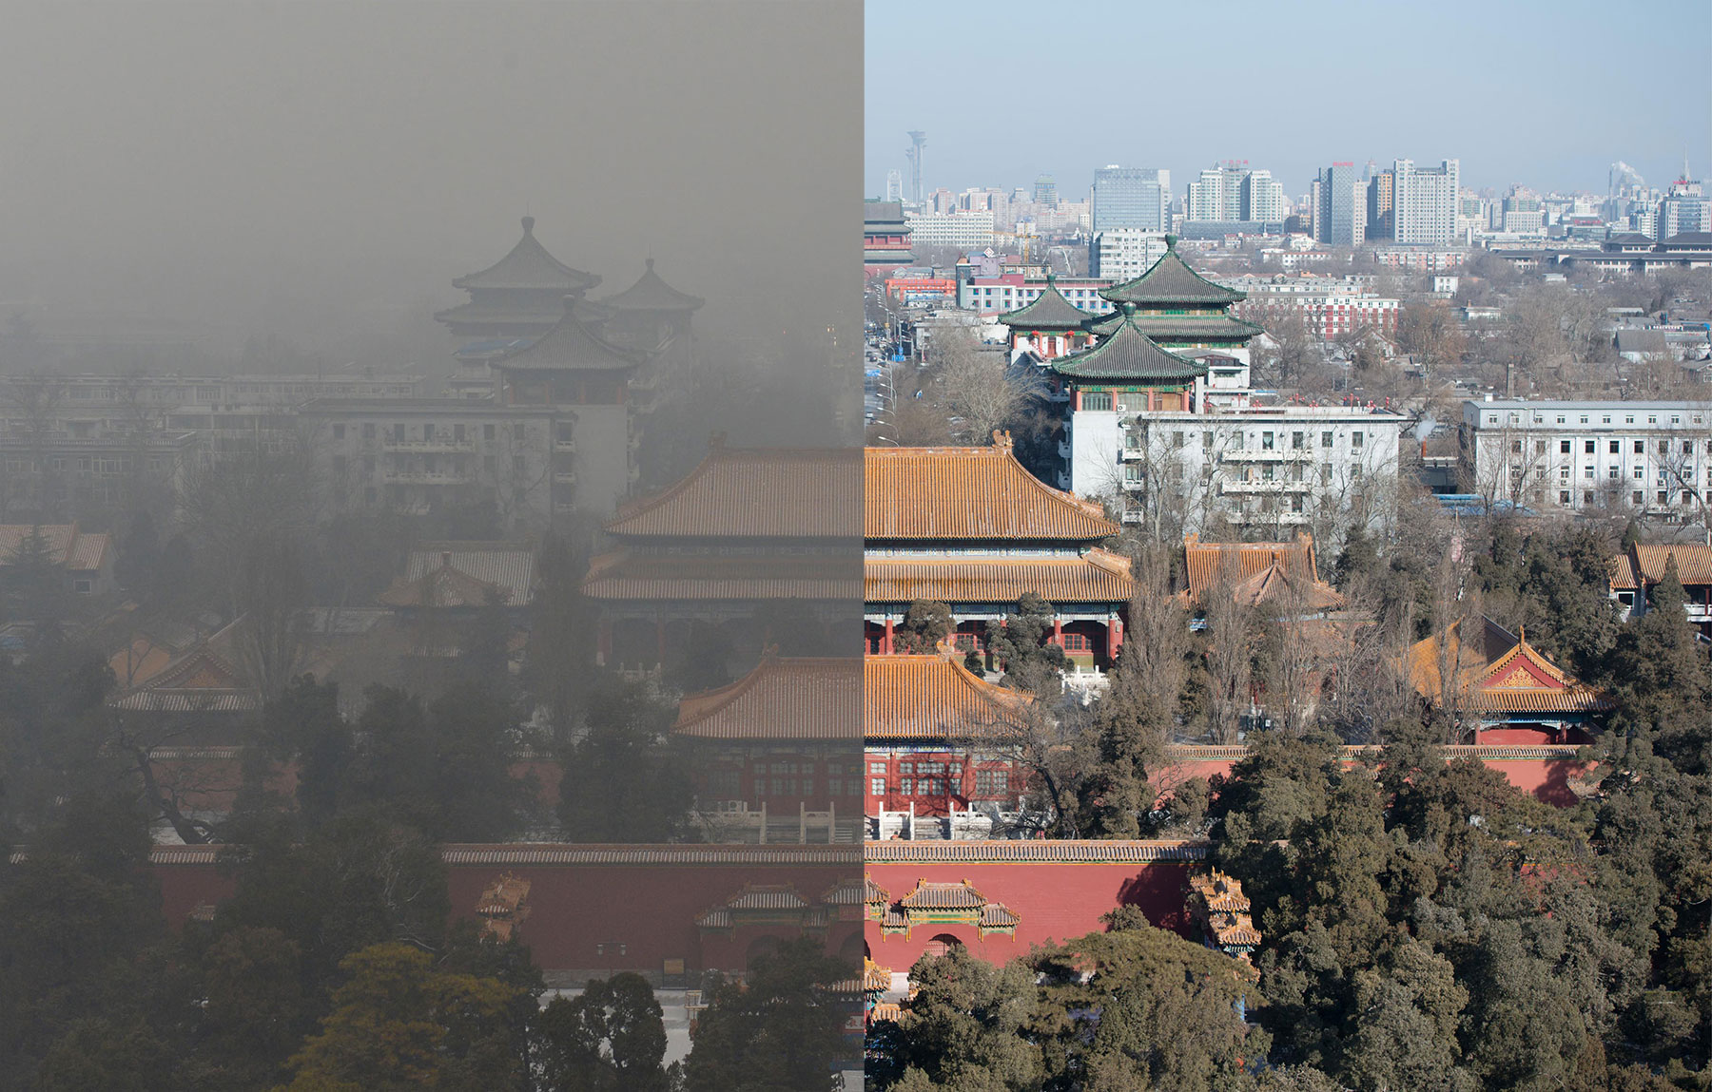
Beijing - Jan 2013

Slide 3
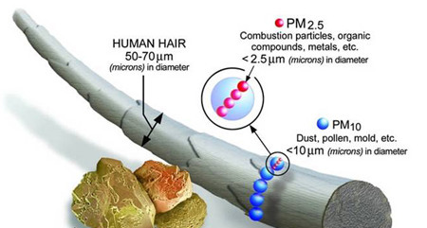
Particulate Matter is very dangerous
Causes major health problems:
Cardiovascular disease, lung cancer, heart attacks, bronchitis, asthma…

Slide 4
Particulate Matter is very dangerous
Over 3 million people die prematurely each year from particulate matter air pollution
Causes major health problems:
Cardiovascular disease, lung cancer, heart attacks, bronchitis, asthma…

Slide 5
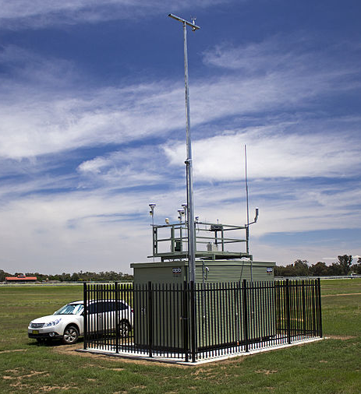
We need data!
Ground-based monitoring is very expensive
Satellite data is a lot cheaper
Global, but… very low resolution

Slide 6
We need data!
Ground-based monitoring is very expensive
Satellite data is a lot cheaper
Global, but… very low resolution
We need high resolution satellite data

Slide 7
HOTBAR
MODIS
HOTBAR
Over 100,000 times the detail

Slide 8
Vision: Accurate high spatial & temporal resolution air quality measurements
Extend, Validate, Apply

Slide 9
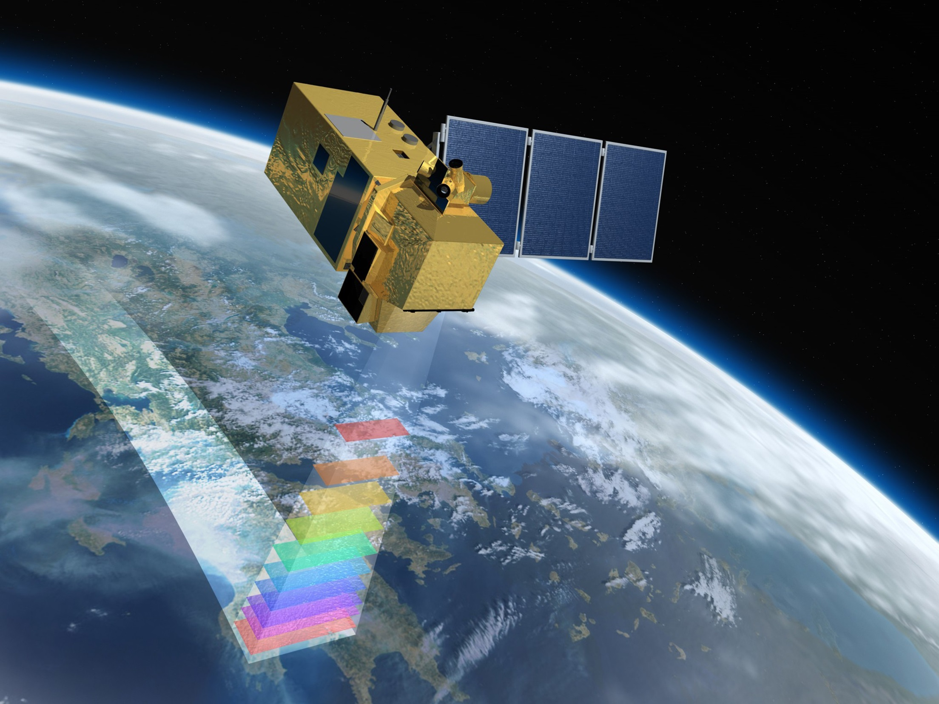
Extend

Slide 10
Extend
New satellites
Improved, automated algorithm
Aerosol modelling (van Donkelaar)

Slide 11
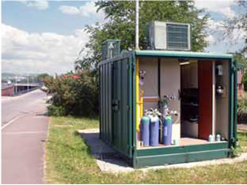
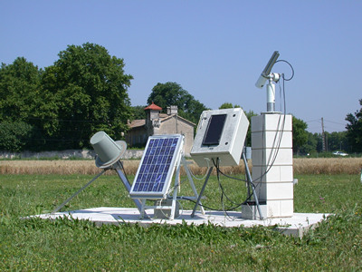
Validate

Slide 12
Validate
Ground-based measurements
Other satellite measurements
Model outputs

Slide 13
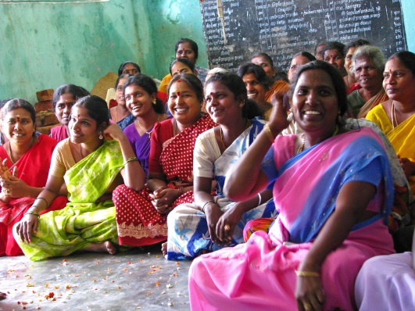
Apply

Slide 14
Apply
Focus on LMICs
Focus on applications that require high spatial detail
Driven by collaborators within the centre

Slide 15
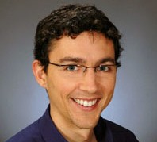
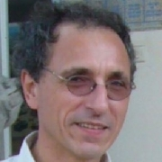
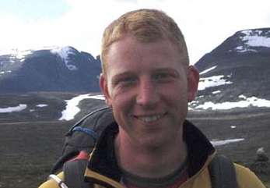
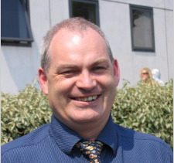
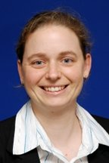
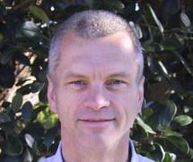
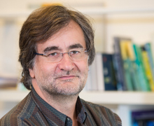
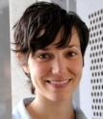
My
collaborators

Slide 16
?
Lectureship
RCUK fellowship
This fellowship
Perfect start!

Slide 17
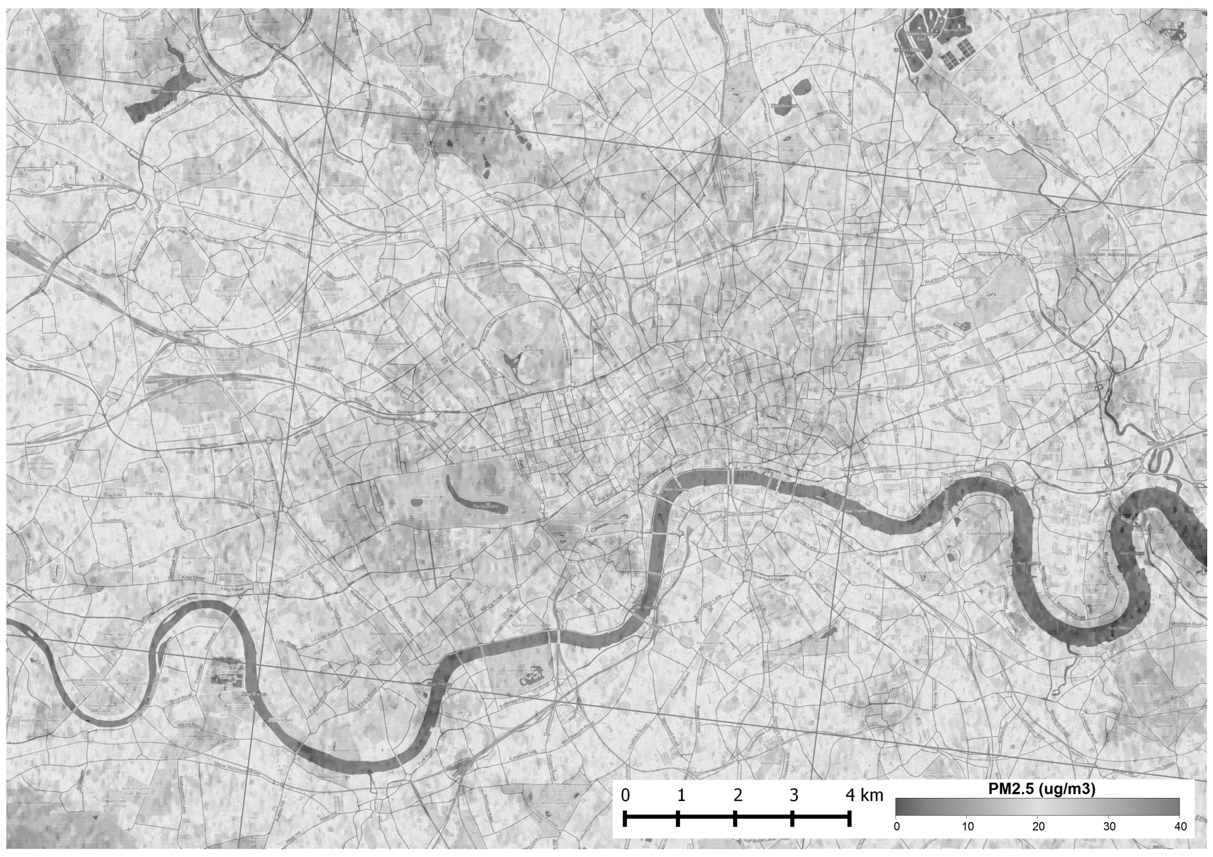
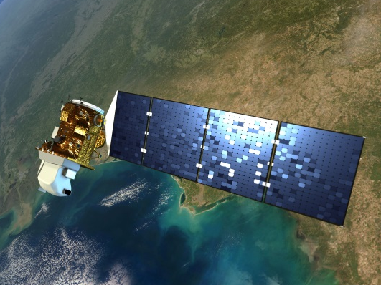
Opportunity to be at the forefront of a revolutionary method in exposure assessment
Extend, Validate, Apply

